Slide 2
Taking Tests
Sometimes at school, I might need to do a test.
Tests help teachers to find out exactly what I have learnt and what I might need help with.
It is important that my answers show what I know or do not yet know so I may need to work alone or with minimal help.

Slide 3
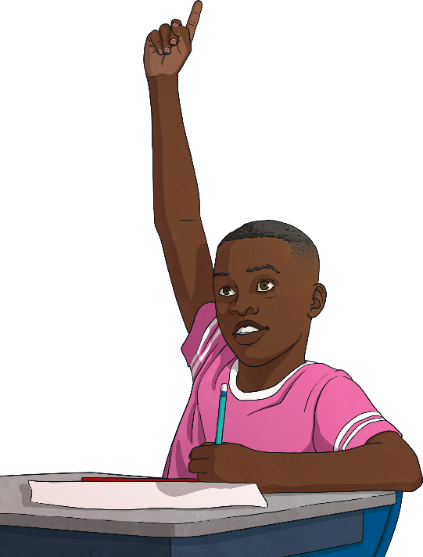
Where Will I Be for My SATs?
For my tests, I might be in my classroom, in the hall or maybe in a smaller room. My teachers will make sure that I do my tests somewhere suitable for me.
I might have my own table or desk to sit at away from my classmates. This helps me to concentrate and makes sure that we are all giving our own answers. It is important that I stay at my table or desk until a teacher tells me I can go.
There will be teachers in the room to make sure that I am ok. I can raise my hand if I need them to come to me.

Slide 4
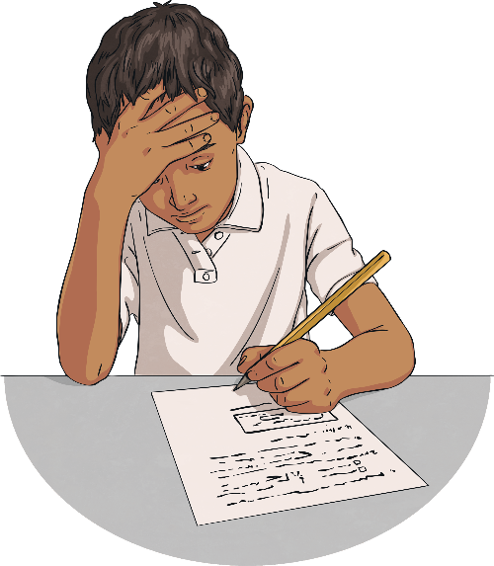
Will the Tests Be Difficult?
The questions in my tests will ask me about lots of things I have been learning about.
I might be able to answer some of the questions very easily but I might find other questions difficult. That’s okay though because I do not need to answer every question correctly.
If I do not know an answer, I can choose to answer with my best guess or I can move on to the next question. I can come back to a question later and try again if there is still time left.

Slide 5
Will I Have Help?
The tests are there to help teachers to find out what I already know and what I need to learn so I might not be able to have as much help as I would in a lesson.
My teachers will decide what help I might need during the tests based on the help I have in my usual lessons. If I usually have my work enlarged or read to me, I might still get that help in the tests. I can ask my teacher about this if I am not sure.
If I need to ask a question during the tests, such as asking how much time is left or where I need to write my answers, I can raise my hand and a teacher will come over to me.

Slide 6
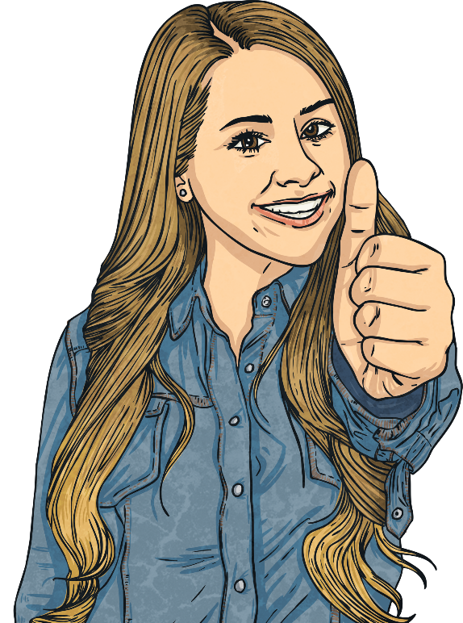
SATs Affirmations
I can do my best.
I am proud of my efforts.
I can make positive choices.
It is okay to find things difficult - that’s how I learn new things.
I can be resilient.

