Slide 1
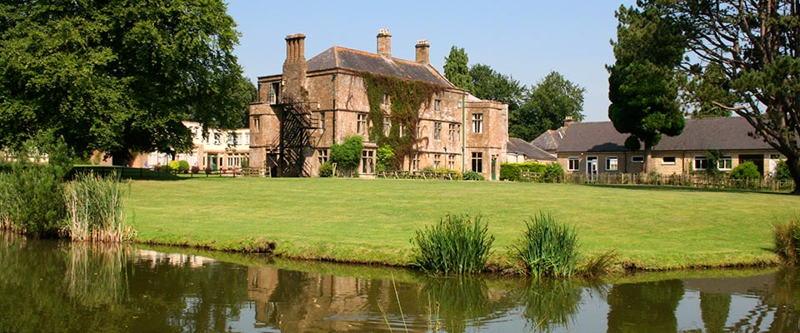
Hooke Court 2025 Wednesday 15th January – Friday 17th January

Slide 2
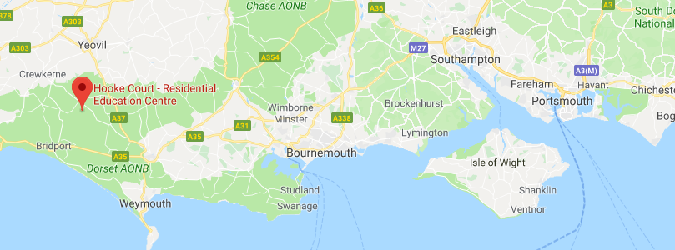
Why do we go to Hooke Court?
Beaminster, Dorset.
2.5 hrs on coach
Around £200
£60 deposit

Slide 3
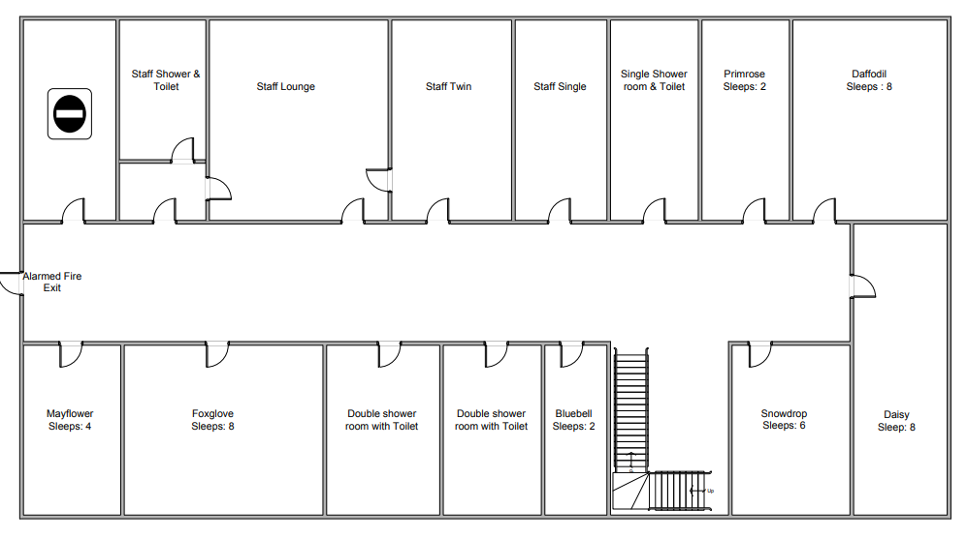
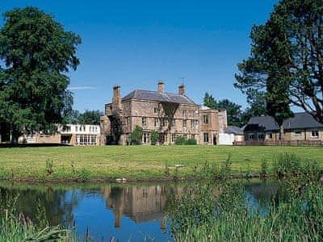
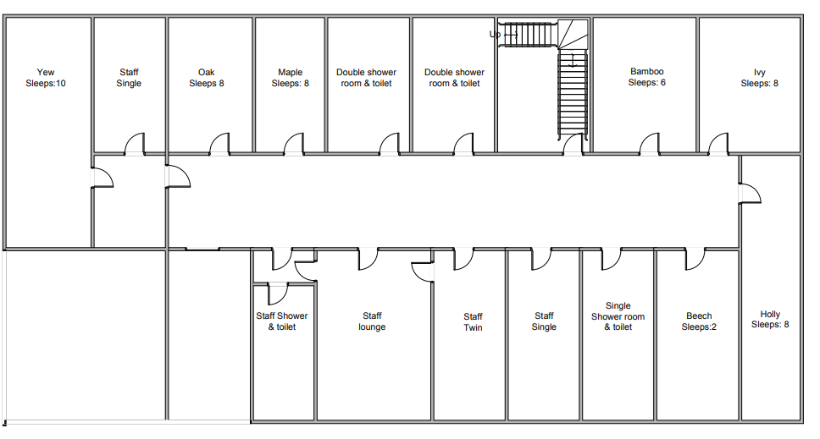

Slide 4
Timetable
Wednesday
9.30 - Depart Craneswater
12.00 - Arrive at Hooke Court
History of Hooke Court/ Game
Building construction
Free time
Dinner
Stone Age art
Friday
Breakfast
Stone Age crafts – making jewellery and clay pots.
Making food and cooking on the open fire!
Lunch
12.30 - Depart Hooke Court
3.30ish - Arrive back at Craneswater
Thursday
Breakfast
Time team dig
Lunch
Stone Age experience – wattle and daubing etc
Free time (shop)
Dinner
Evaluation of finds
Sleeping arrangements

Slide 5
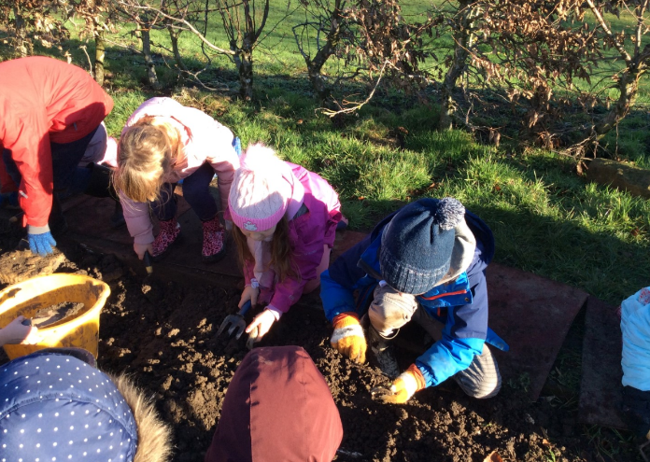
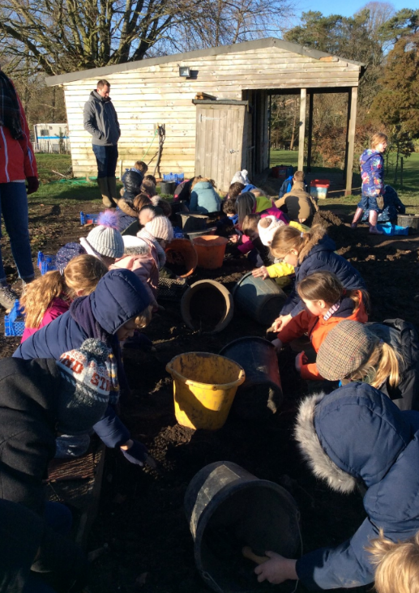
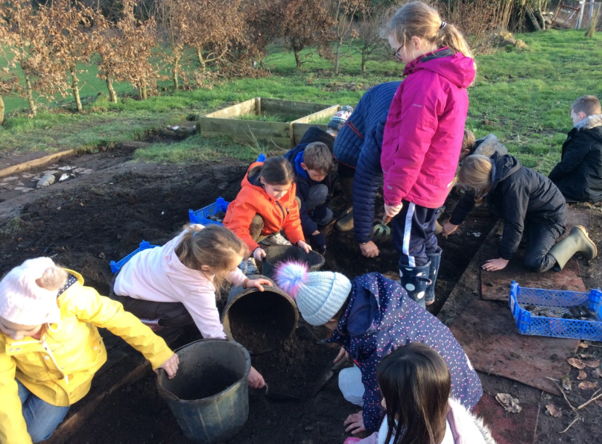
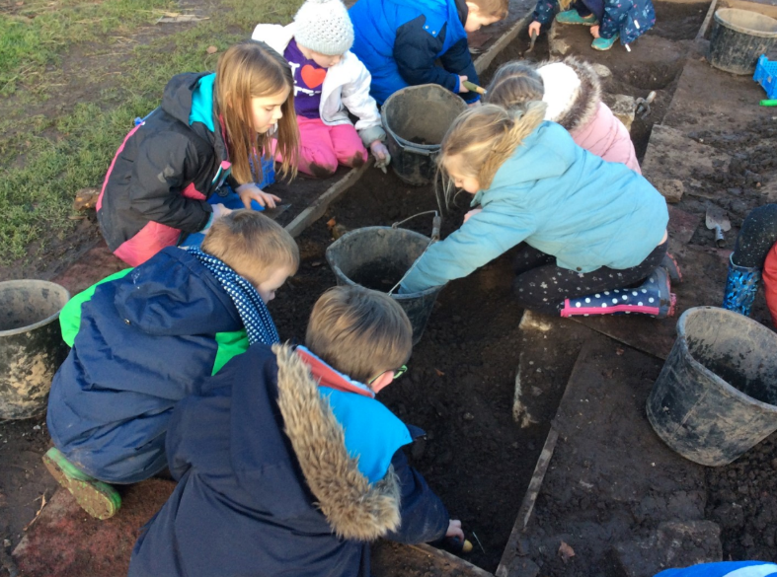
Time Team dig

Slide 6
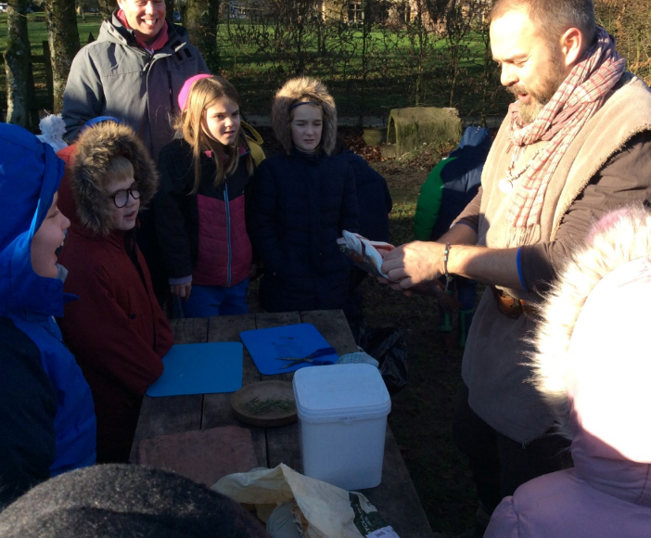
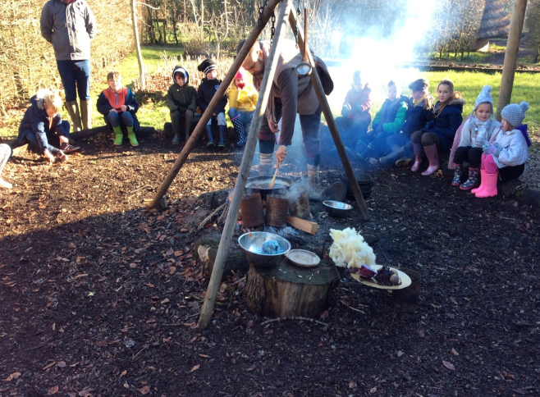
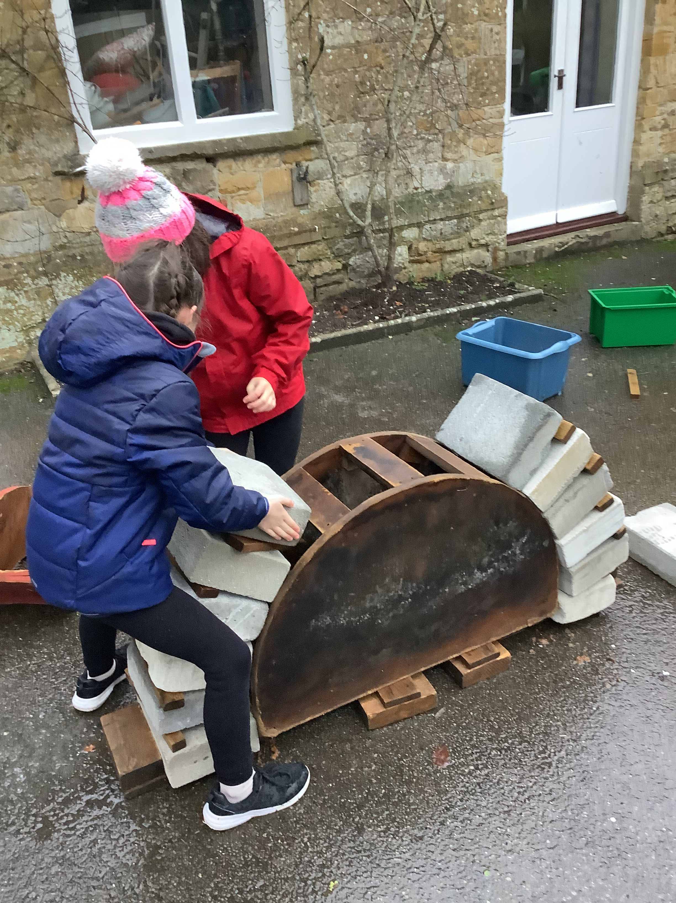
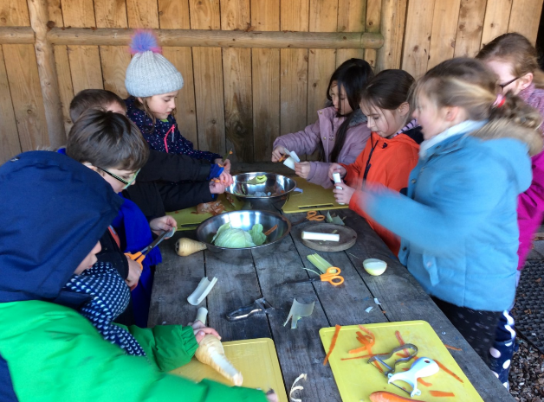
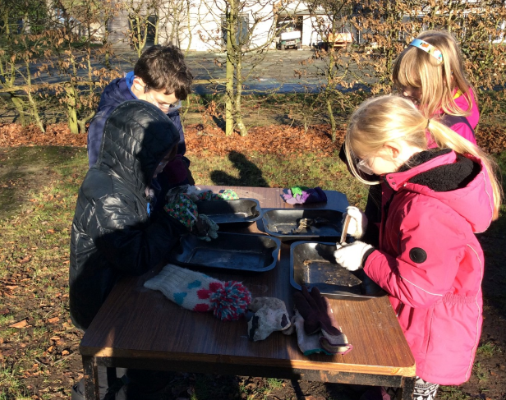
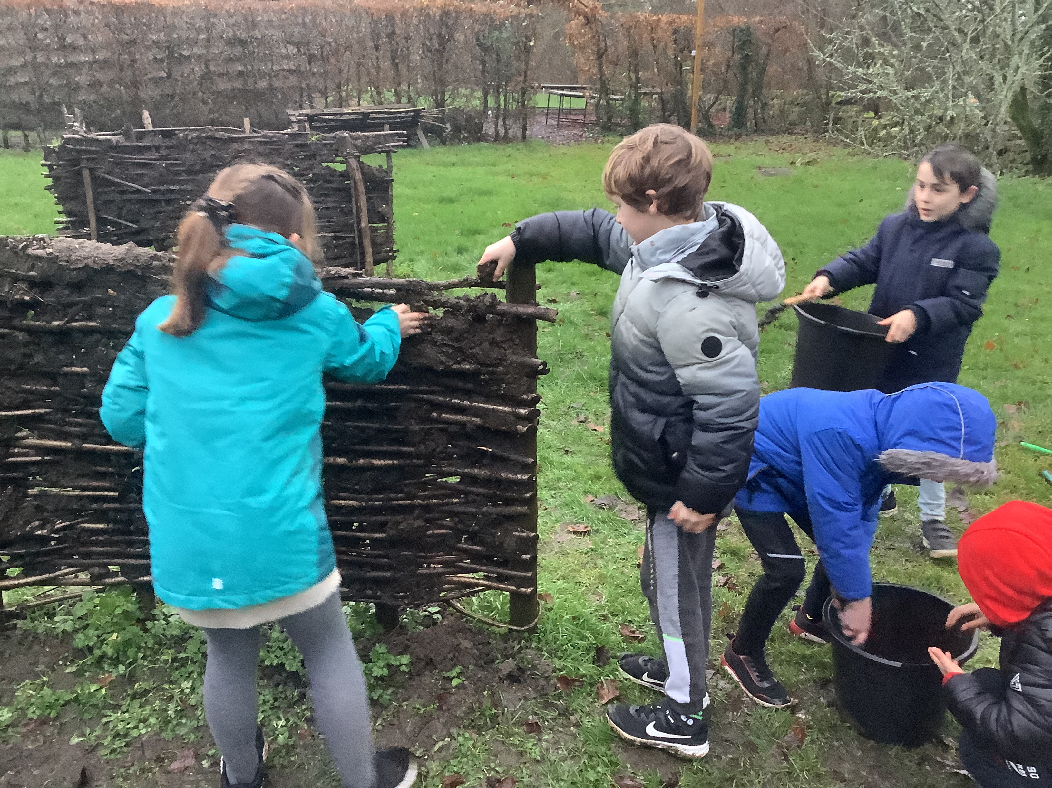
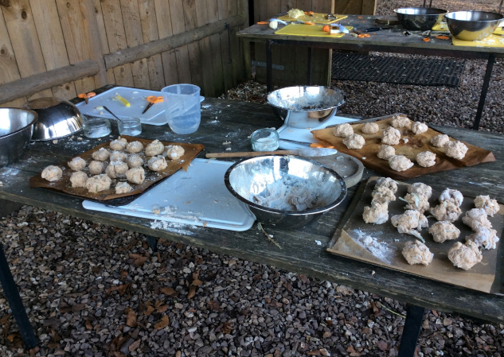
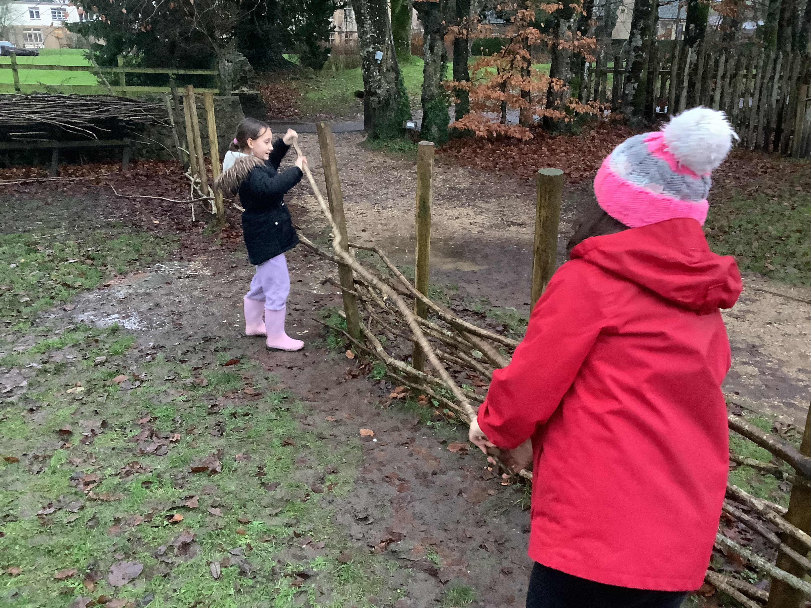
Stone Age experience

Slide 7
Mrs Gray and other year 3 staff will remain at school with the children that decide not to go.
They will be completing lots of fun stone age activities and even get a visit from a stone age man!
No maths or English!

